Slide 1
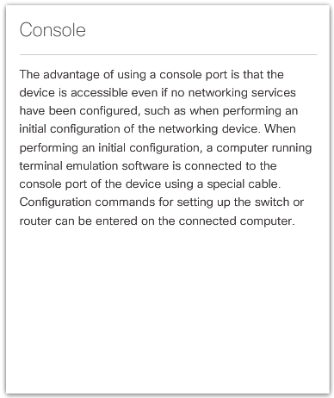
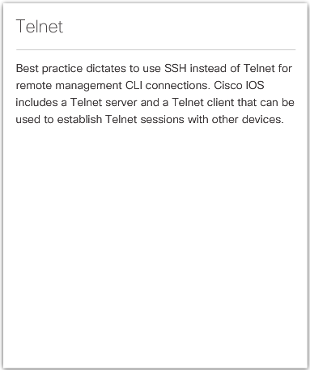
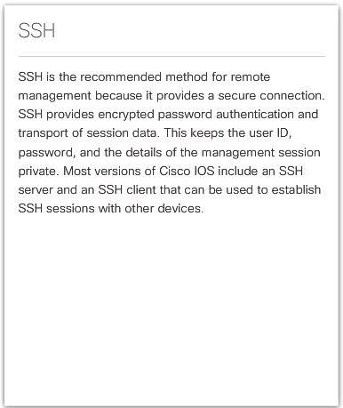
Access Methods
Notes:
2.1.2.1 Access Methods

Slide 2
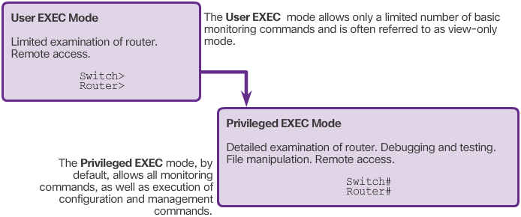
Primary Command Modes
Notes:
2.1.3.2 Primary Command Modes

Slide 3
Configuration Command Modes
Global Configuration Mode
To configure the device must enter this mode with configure terminal command
Example: Switch(config)#
CLI configuration changes are made that affect the operation of the device as a whole
From this mode, the user can enter different sub-configuration modes
Two common sub-configuration modes include:
Line Configuration Mode - Used to configure console, SSH, Telnet, or AUX access. Example: Switch(config-line)#
Interface Configuration Mode - Used to configure a switch port or router network interface. Example: Switch(config-if)#
Notes:
2.1.3.3 Configuration Command Modes

Slide 4
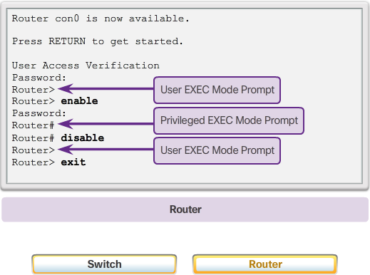
Navigate Between IOS Modes
Notes:
2.1.3.4 Navigate Between IOS Modes

Slide 5
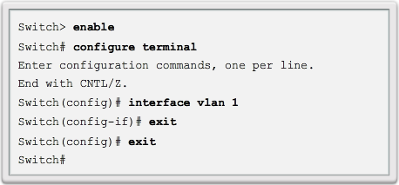
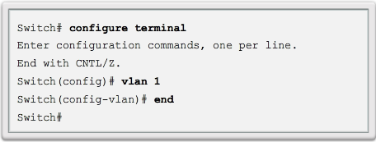
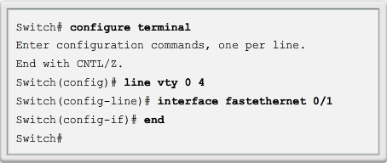
Navigate Between IOS Modes (cont.)
Exit
End or Ctrl+Z
Notes:
2.1.3.4 Navigate Between IOS Modes

Slide 6
Topic 2.1.4: The Command Structure

Slide 7
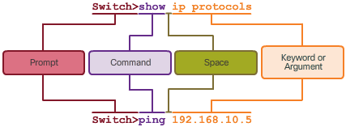
Basic IOS Command Structure
Notes:
2.1.4.1 Basic IOS Command Structure

Slide 8
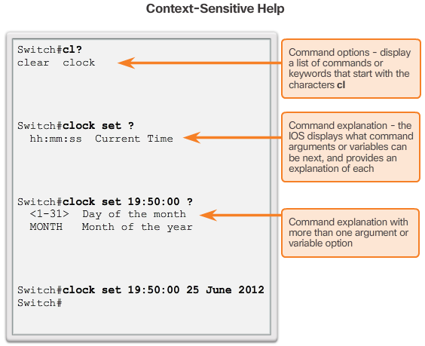
IOS Help Features
Video Available
Notes:
2.1.4.3 IOS Help Features

Slide 9
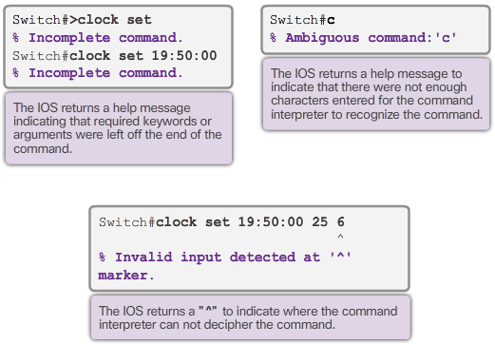
IOS Help Features (cont.)
Notes:
2.1.4.3 IOS Help Features

Slide 10
Hotkeys and Shortcuts
Tab – Completes the remainder of a partially typed command or keyword
Ctrl-R – Redisplays a line
Ctrl-A – Moves cursor to the beginning of the line
Ctrl-Z – Exits configuration mode and returns to user EXEC
Down Arrow – Allows the user to scroll forward through former commands
Up Arrow – Allows the user to scroll backward through former commands
Ctrl-Shift-6 – Allows the user to interrupt an IOS process such as ping or traceroute.
Ctrl-C – Aborts the current command and exits the configuration mode
Notes:
2.1.4.4 Hotkeys and Shortcuts
2.1.4.5 Video Demonstration – Hotkeys and Shortcuts
2.1.4.6 Packet Tracer – Navigating the IOS
2.1.4.7 Lab – Establishing a Console Session with Tera Term

Slide 11
Section 2.2: Basic Device Configuration
Upon completion of this section, you should be able to:
Configure hostnames on a Cisco IOS device using the CLI.
Use Cisco IOS commands to limit access to device configurations.
Use IOS commands to save the running configuration.

Slide 12
Topic 2.2.1: Hostnames

Slide 13

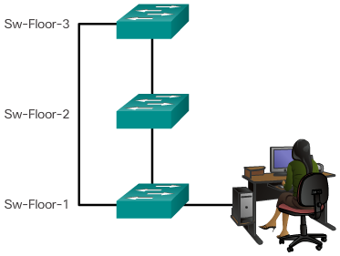
Device Names
Guidelines to Choose a Hostname
Configuring Device Names
Hostnames allow devices to be identified by network administrators over a network or the Internet.
Notes:
2.2.1.1 Device Names

Slide 14

Configure Hostnames
Notes:
2.2.1.2 Configure Hostnames

Slide 15
Topic 2.2.2: Limit Access to Device Configurations

Slide 16
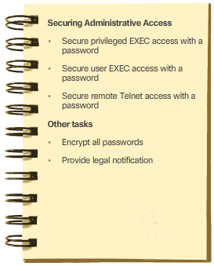
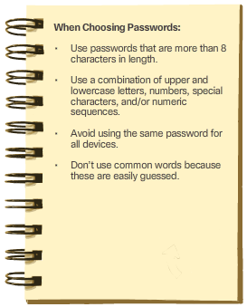
Secure Device Access
Notes:
2.2.2.1 Secure Device Access

Slide 17
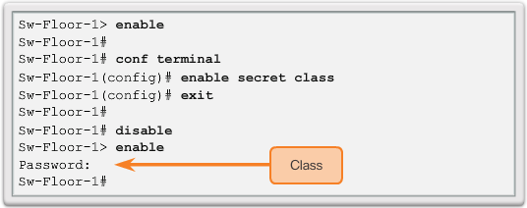
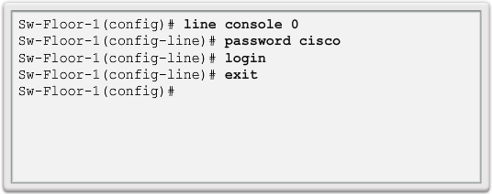
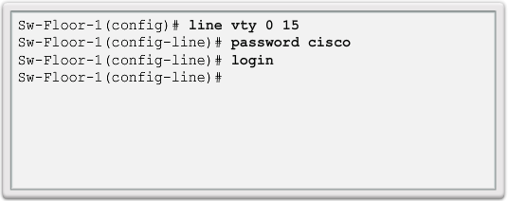
Configure Passwords
Privileged EXEC Password Example
User EXEC Password Example
VTY Line Password Example
Notes:
2.2.2.2 Configure Passwords

Slide 18
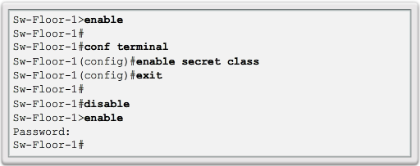
Configure Passwords (cont.)
Use the enable secret command, not the older enable password command.
The enable secret command provides greater security because the password is encrypted.
Notes:
2.2.2.2 Configure Passwords

Slide 19
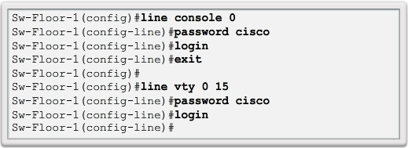
Configure Passwords (cont.)
Console port must be secured.
Reduces the chance of unauthorized personnel physically plugging a cable into the device and gaining device access.
VTY lines allow access to a Cisco device via Telnet.
The number of VTY lines supported varies with the type of device and the IOS version.
Notes:
2.2.2.2 Configure Passwords

Slide 20
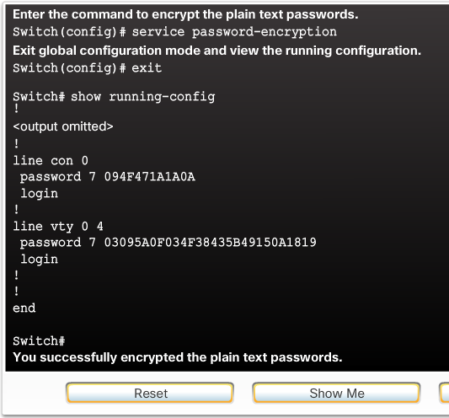
Encrypt Passwords
service password-encryption
Prevents passwords from showing up as plain text when viewing the configuration.
Purpose of this command is to keep unauthorized individuals from viewing passwords in the configuration file.
After this command is applied, removing the encryption service does not reverse the encryption
Notes:
2.2.2.3 Encrypt Passwords

Slide 21
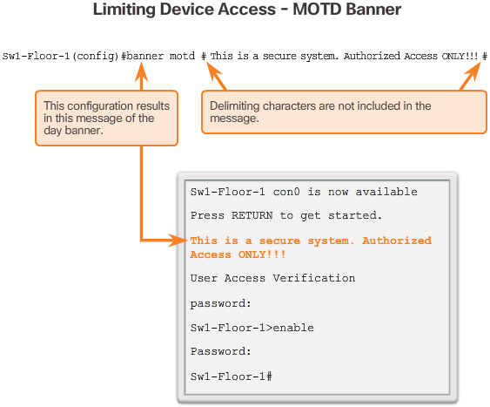
Banner Messages
These are an important part of the legal process in the event that someone is prosecuted for breaking into a device.
Wording that implies that a login is "welcome" or "invited" is not appropriate.
Often used for legal notification because it is displayed to all connected terminals.
Notes:
2.2.2.4 Banner Messages
2.2.2.5 Syntax Checker - Limiting Access to a Switch

Slide 22
Topic 2.2.3: Save Configurations

Slide 23
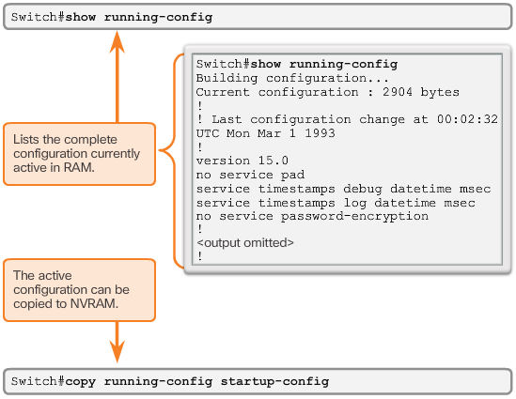
Save the Running Configuration File
Startup configuration –File stored in NVRAM that contains all of the commands that will be used upon startup or reboot. NVRAM does not lose its contents when the device is powered off.
Running configuration – File stored in RAM that reflects the current configuration, modifying affects the operation of a Cisco device immediately. RAM loses all of its content when the device is powered off or restarted.
Notes:
2.2.3.1 Save the Running Configuration File

Slide 24
Alter the Running Configuration
Restore the device to its previous configuration by removing the changed commands individually.
Copy the startup configuration file to the running configuration with the copy startup-config running-config privileged EXEC mode command.
Reload the device with the reload command from privileged EXEC mode.
Switch# reload
System configuration has been modified. Save? [yes/no]: n
Proceed with reload? [confirm]
Notes:
2.2.3.2 Video Tutorial: Alter the Running Configuration

Slide 25
Section 2.3: Address Schemes
Chapter Objectives:
Explain how devices communicate across network media.
Configure a host device with an IP address.
Verify connectivity between two end devices.

Slide 26
Topic 2.3.1: Ports and Addresses

Slide 27
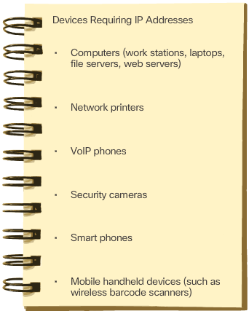
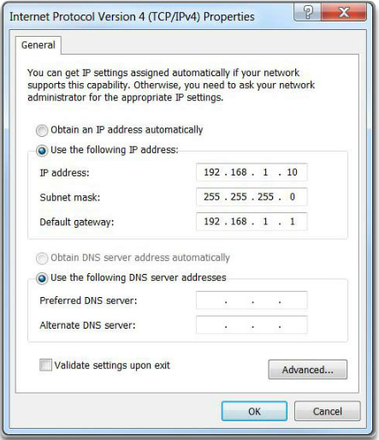
IP Addresses
Configuring a Static IP Address on a Host
Connecting End Devices
Notes:
2.3.1.1 IP Addresses

Slide 28
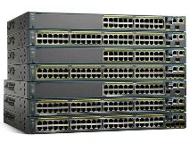
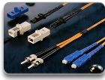
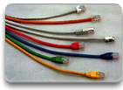
Interfaces and Ports
Network communications depend on end user device interfaces, networking device interfaces, and the cables that connect them.
Types of network media include twisted-pair copper cables, fiber-optic cables, coaxial cables, or wireless.
Different types of network media have different features and benefits.
Ethernet is the most common local area network (LAN) technology.
Ethernet ports are found on end user devices, switch devices, and other networking devices.
Cisco IOS switches have physical ports for devices to connect to, but they also have one or more switch virtual interfaces (SVIs). No physical hardware on the device is associated with it. It is created in software.
SVI provides a means to remotely manage a switch over a network.
Notes:
2.3.1.2 Interfaces and Ports

Slide 29
Topic 2.3.2: Configure IP Addressing

Slide 30
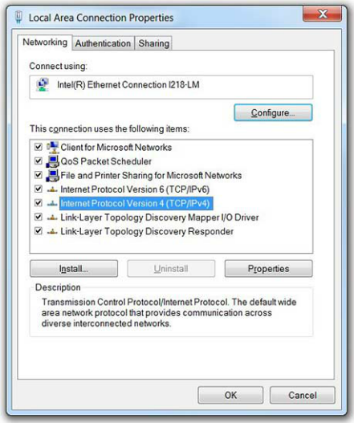
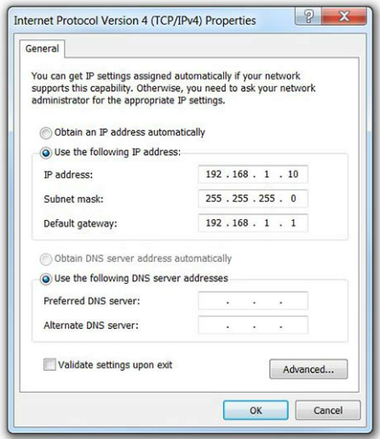
Manual IP Address Configuration for End Devices
Manually Assigning IPv4 Address Information
Ethernet Adapter Properties
Notes:
2.3.2.1 Manual IP Address Configuration for End Devices

Slide 31
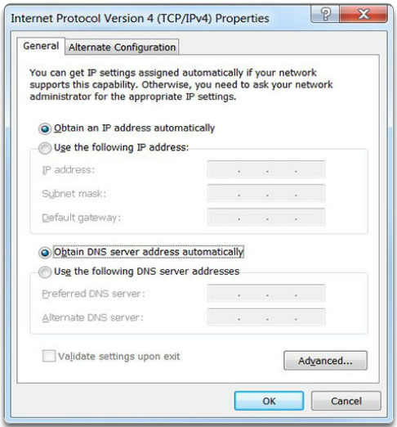
Automatic IP Address Configuration for End Devices
Assigning Dynamic Addresses
Notes:
2.3.2.2 Automatic IP Address Configuration for End Devices

Slide 32
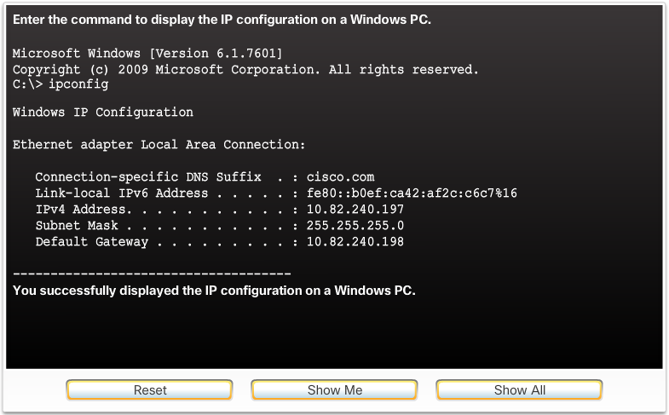
Automatic IP Address Configuration for End Devices (cont.)
Verifying Windows PC IP Configuration
Notes:
2.3.2.2 Automatic IP Address Configuration for End Devices (Cont.)

Slide 33
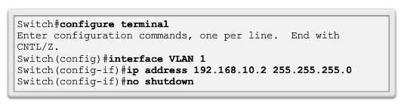
Switch Virtual Interface Configuration
Video Available
IP address - Together with subnet mask, uniquely identifies end device on internetwork
Subnet mask - Determines which part of a larger network is used by an IP address
interface VLAN 1 - Interface configuration mode
ip address 192.168.10.2 255.255.255.0 - Configures the IP address and subnet mask for the switch
no shutdown - Administratively enables the interface
Switch still needs to have physical ports configured and VTY lines to enable remote management
Notes:
2.3.2.3 Switch Virtual Interface Configuration
2.3.2.4 Syntax Checker – Configuring a Switch Virtual Interface
2.3.2.5 Packet Tracer – Implementing Basic Connectivity

Slide 34
Topic 2.3.3: Verifying Connectivity

Slide 35
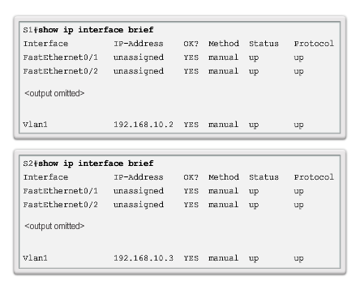
Interface Addressing Verification
Video Available
Notes:
2.3.3.1 Interface Addressing

Slide 36
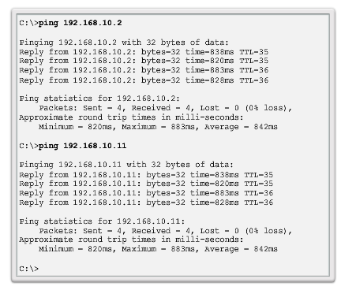
End-to-End Connectivity Test
Video Available
Notes:
2.3.3.2 End-to-End Connectivity Test
2.3.3.3 Lab – Building a Simple Network
2.3.3.4 Lab – Configuring a Switch Management Address

Slide 37
Section 2.4: Summary
Chapter Objectives:
Explain the features and functions of Cisco IOS Software.
Configure initial settings on a network device using the Cisco IOS software.
Given an IP addressing scheme, configure IP address parameters on end devices to provide end-to-end connectivity in a small to medium-sized business network.
Notes:
2.4.1.1 Class Activity - Tutor Me
2.4.1.2 Packet Tracer - Skills Integration Challenge
2.4.1.3 Chapter 2: Configure a Network Operating System

